Slide 1
Cybersecurity
Data Injection

Slide 2
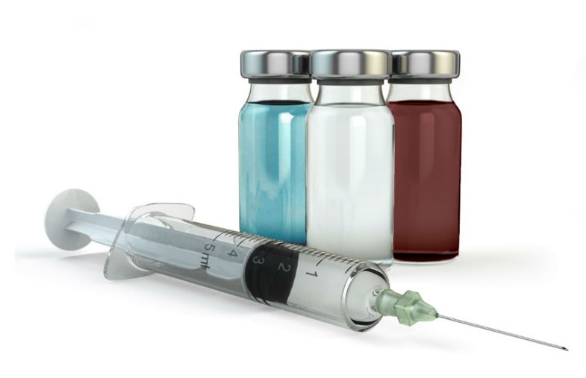
Code Injection
Add extraneous information into program
Bad/lazy programming allows it
The application should properly handle input and output
“Sanitize” input (ensure only restricted choices when gleaning input from users)
So many different places to inject code
HTTP, SQL, XML, LDAP, etc…

Slide 3
SQL Injection
SQL – Structured Query Language
The most common database language
Most data stored in databases, most databases use SQL
SQL Injection
Modifying SQL requests
Application receives user input but does not check or restrict user’s input.
Programs should never allow this!

Slide 4
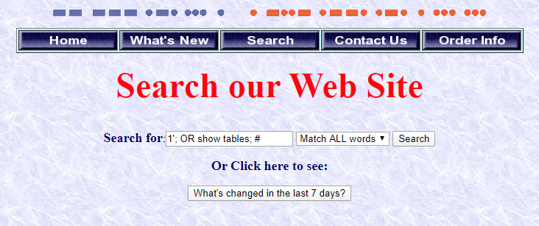
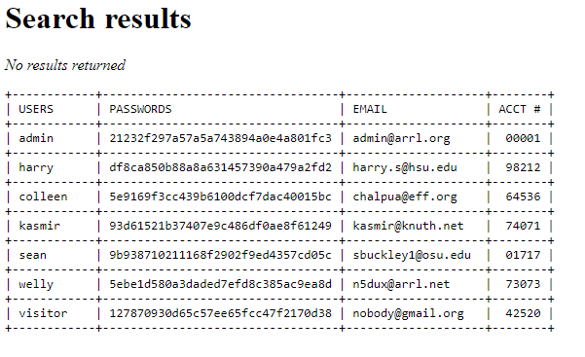
Example

Slide 5


Slide 6
XML and LDAP Injection
XML – Extensible Markup Language
Data format for data transfer and storage
XML Injection
Modifying XML requests – a good application will validate
Used by JSON in rich web apps
LDAP – Lightweight Directory Access Protocol
Used for providing structured access to file systems, user authentication
LDAP Injection
Manipulate application results by altering LDAP requests

